Slide 1




On Skyline Groups
Chengkai Li¹, Nan Zhang², Naeemul Hassan¹, Sundaresan Rajasekaran², Gautam Das^{1,3}
¹University of Texas at Arlington, ²George Washington University, ³Qatar Computing Research Institute
1
Notes:
do a video record of yourself

Slide 2
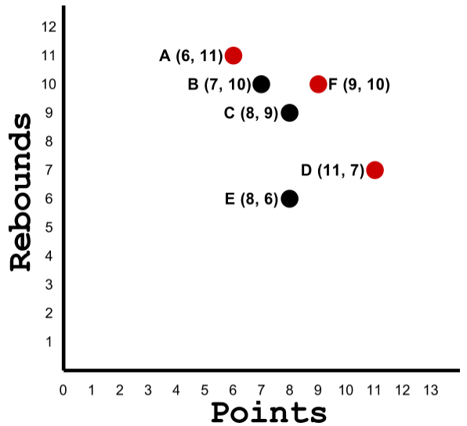
Motivating Example
Dream Team
 | Points | Rebounds | Blocks
Michael Jordan | 3 | 4 | 5
Lebron James | 4 | 2 | 3
Kobe Bryant | 4 | 5 | 3
Skyline Groups
SUM | 11 | 11 | 11
MIN | 3 | 2 | 3
MAX | 4 | 5 | 5
Another Team
SUM | 12 | 11 | 11
2
Notes:
Do not talk about Skyline tuple. Directly explain Skyline Groups

Slide 3

Applications
Find a group of experts
Software Development
Review a Paper
 | Testing | Coding | Design
Applicant_1 | 10 | 20 | 15
Applicant_2 | 8 | 15 | 16
Applicant_3 | 11 | 18 | 15
 | Database | Security | Algorithm
Reviewer_1 | 41 | 35 | 23
Reviewer_2 | 45 | 31 | 34
3
Notes:
there are lots of real life scenarios where we need to form a group
Billion dollar online fantasy game business

Slide 4

Problem & Challenges
n tuples
group size k
Baseline Framework
group generation
(SUM / MIN / MAX)
skyline operation
= 1 X 10³³
n = 1 Million
k = 6
all skyline groups
12816
n choose k is very large, we may not afford to compute or store that.
Number of skyline groups can also be large.
4
Notes:
n tuples
m att
k tuple skyline group , replace the whole sentence

Slide 5
Our Framework
Search Space Pruning
(OSM/WCM)
Skyline Operation &
Output Pruning
Post Processing
input pruning
n, k
n'
n >> n'
Candidate Groups
Unique
Skyline Vectors
All
Skyline Groups
These Skyline Groups can be input of further post-processing algorithms.
Representative Skyline Groups
Rank the Skyline Groups
5
Notes:
dont use m

Slide 6
Search Space Pruning:OSM
P1
P2
P3
P4
P5
6

Slide 7
Search Space Pruning:OSM
P1
P2
P3
P4
P5
6

Slide 8
Search Space Pruning:OSM
P1
P2
P3
P4
P5
6

Slide 9
Search Space Pruning:OSM
Order the tuples arbitrarily as
D_{n} = {P1, P2, ..., Pn}
P1
P2
P3
P4
P5
Sky(Dn,k)
A; Pn is present
Sky(D_{n-1}, k-1) U {Pn}
B; Pn is absent
Sky(D_{n-1}, k)
An order based Anti-Monotonic property can be formed.
SUM satisfies this property and it is extended for MIN and MAX by handling corner cases.
6

Slide 10
Search Space Pruning:WCM
If a k-tuple group is in skyline then at least one (k-1)-tuple subset of it will also be in skyline.
It is applicable in distinct value assumption. We extend this to general cases.
We develop an iterative algorithm based on this property.
WCM is satisfied by MIN and MAX. SUM does not satisfy this property.
Sky(D, k-1)
G U {t} where t ∉ G
Candidate(D, k)
Sky(D, k)
7

Slide 11
Input Pruning
If a tuple is dominated by k or more than k tuples, it can be discarded.
Example:
P4 is dominated by 4 players.
All unique skyline vectors can be found without requiring P4.
So, we can exclude P4 from input tuples.
For MAX, it is sufficient to consider only skyline tuples.
 | Points | Rebounds | Blocks
P1 | 3 | 4 | 5
P2 | 4 | 2 | 3
P3 | 4 | 5 | 3
P4 | 2 | 1 | 2
P5 | 4 | 1 | 2
8

Slide 12
Output Pruning
Multiple groups share the same aggregate score.
Instead of all skyline groups, find unique vectors.
All groups can be found by post-processing.
MIN: It is sufficient to find all input tuples which are equal to or dominate a skyline vector and then find k-tuple combination of these; time complexity O(n).
MAX: The problem is NP-hard. But simple brute-force is practically efficient because of small input size.
/
 | Points | Rebounds | Blocks
Michael Jordan Lebron James Kobe Bryant | 4 | 5 | 5
Michael Jordan Lebron James Carmelo Anthony | 4 | 5 | 5
all skyline groups
12816
unique skyline vectors
870
9
Notes:
because of the nature of the MAX and MIN function. Explain how all groups can be found, if time permits. At least talk about O(n) method of MIN and NP completeness but brute force method of MAX.

Slide 13
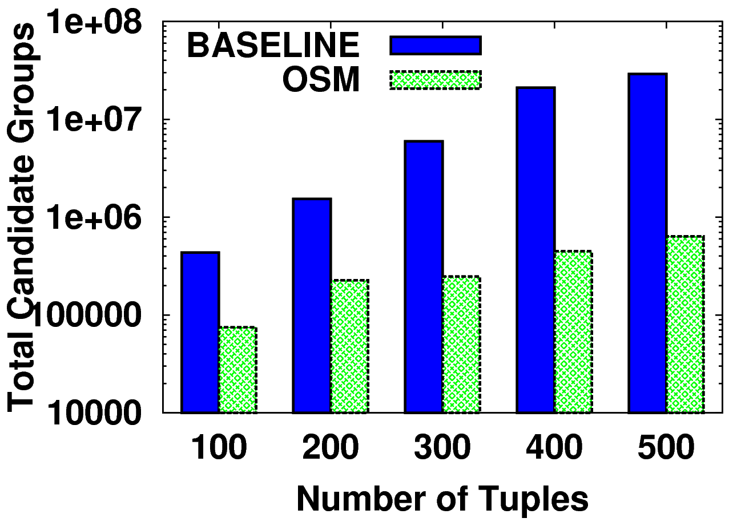
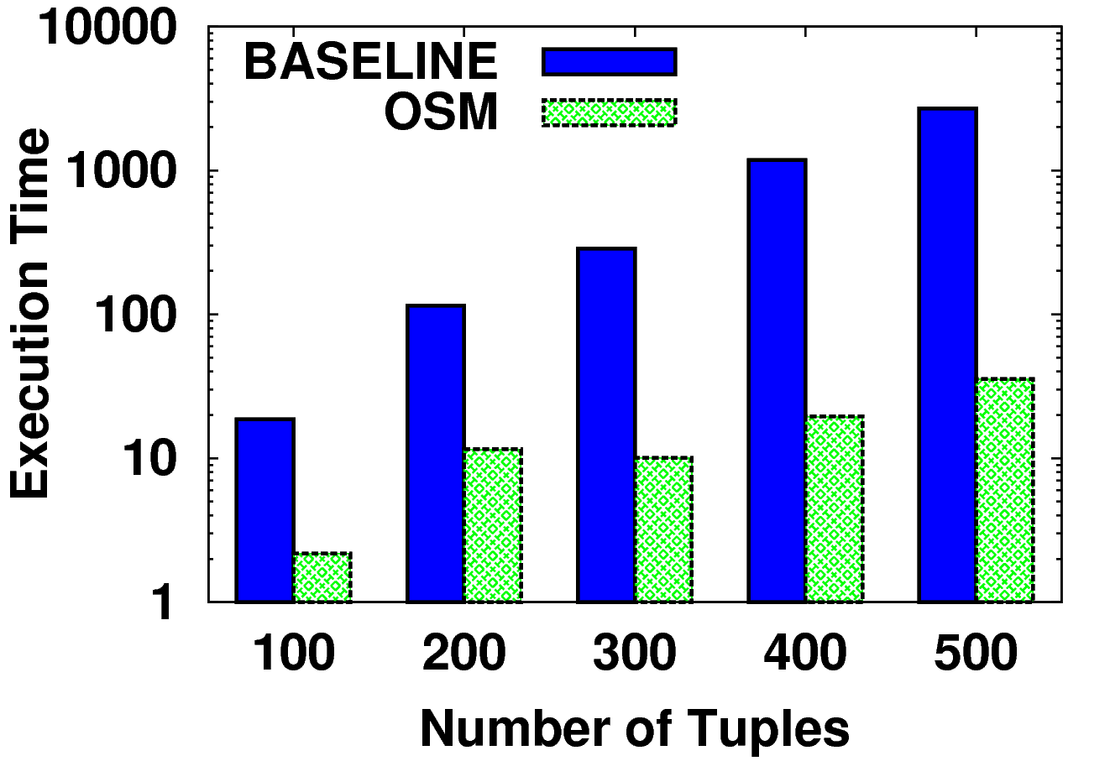
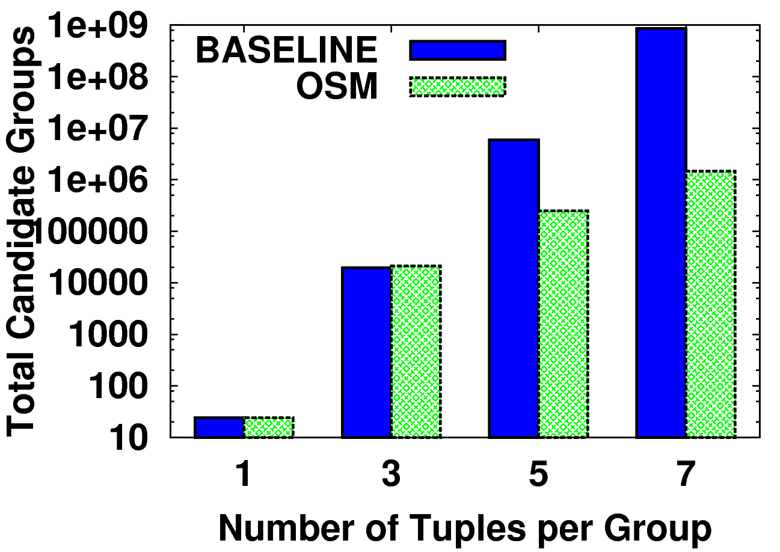
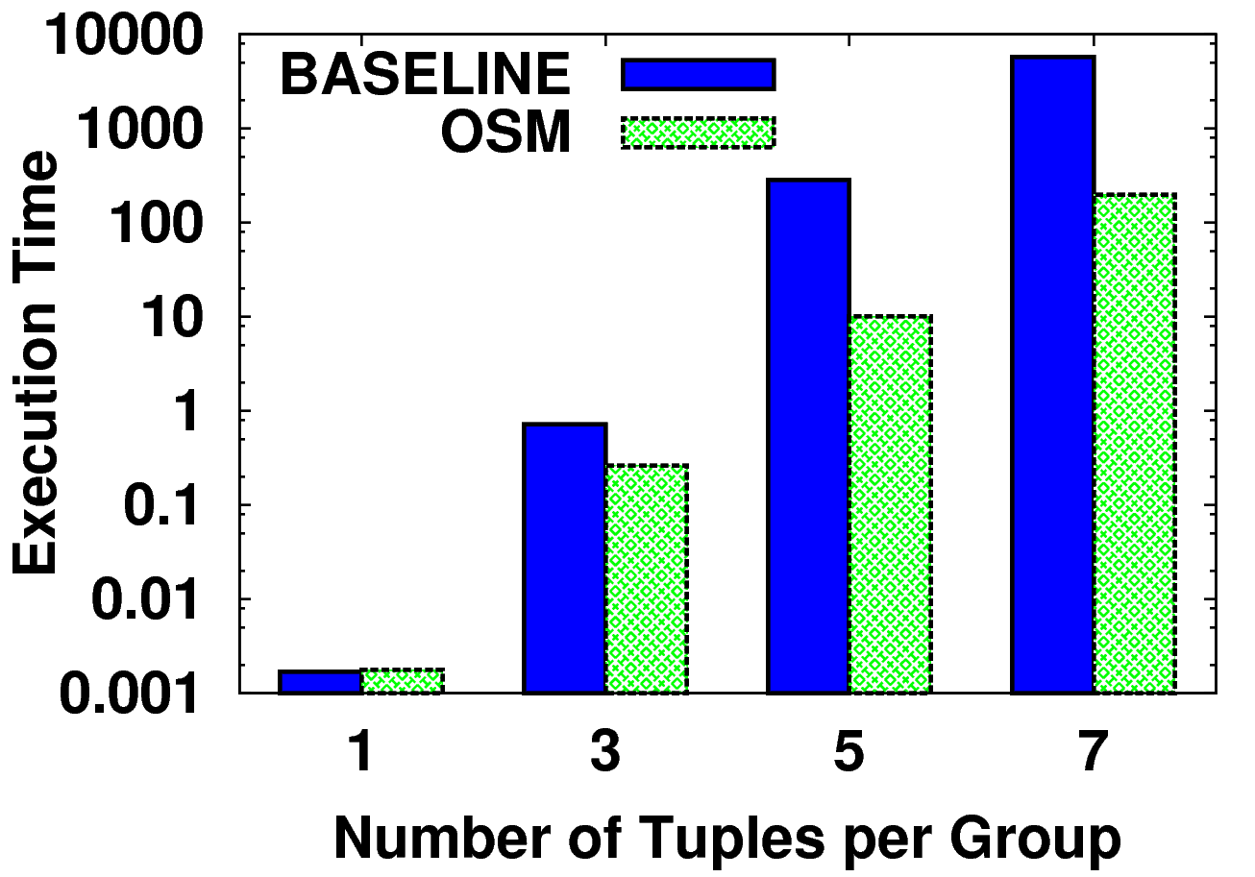
Experiment
NBA Dataset
Synthetic Dataset
Details in our CIKM paper.
group size, k = 5
Total tuples, n = 300
10

Slide 14
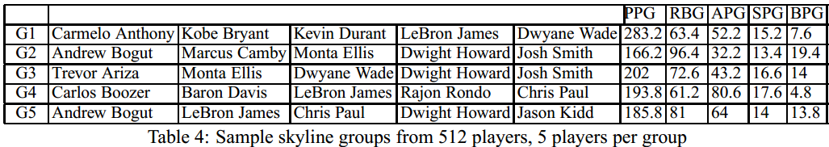
Sample Skyline Groups
11

Slide 15

Future Work
Generalize group aggregate function.
Consume skyline groups.
Journal Link: http://ranger.uta.edu/~cli/
12

Slide 16
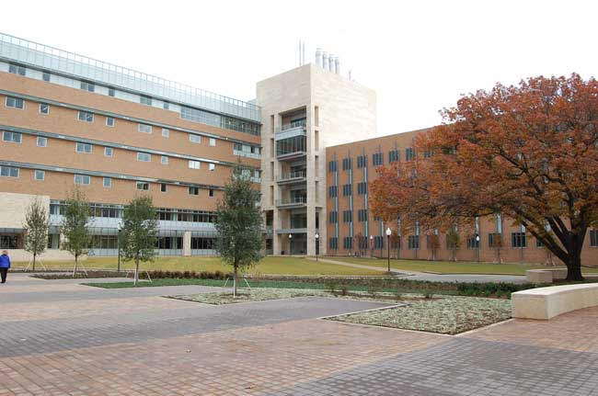

Acknowledgement
Travel Support

Slide 17
Mahalo :-)
feel free to drop any questions/suggestions...
naeemulhassan@gmail.com

Slide 18
Question
?

